Slide 1
ANLY 5332
Department of Information Systems and Analytics
McCoy College of Business Administration
Texas State University
Sensitivity Analyses and Duality

Slide 2
Outline
Sensitivity Analysis and Excel Reports (Chapter 5)
Single Change in the Objective Function (Chapter 5.3)
Single Change in a Constraint (Chapter 5.5)
Effect of Simultaneous Changes
  Changes in the Objective Function (Chapter 5.4)
  Changes in Constraints (Chapter 5.6)
Changes in the Model (not in the textbook)
Linear Programming Duality (not in the textbook)
  Formulating the dual problem
  Primal-dual relations
  Economic Interpretation

Slide 3
Outline
Sensitivity Analysis and Excel Reports (Chapter 5)
Single Change in the Objective Function (Chapter 5.3)
Single Change in a Constraint (Chapter 5.5)
Effect of Simultaneous Changes
  Changes in the Objective Function (Chapter 5.4)
  Changes in Constraints (Chapter 5.6)
Changes in the Model (not in the textbook)
Linear Programming Duality (not in the textbook)
  Formulating the dual problem
  Primal-dual relations
  Economic Interpretation

Slide 4
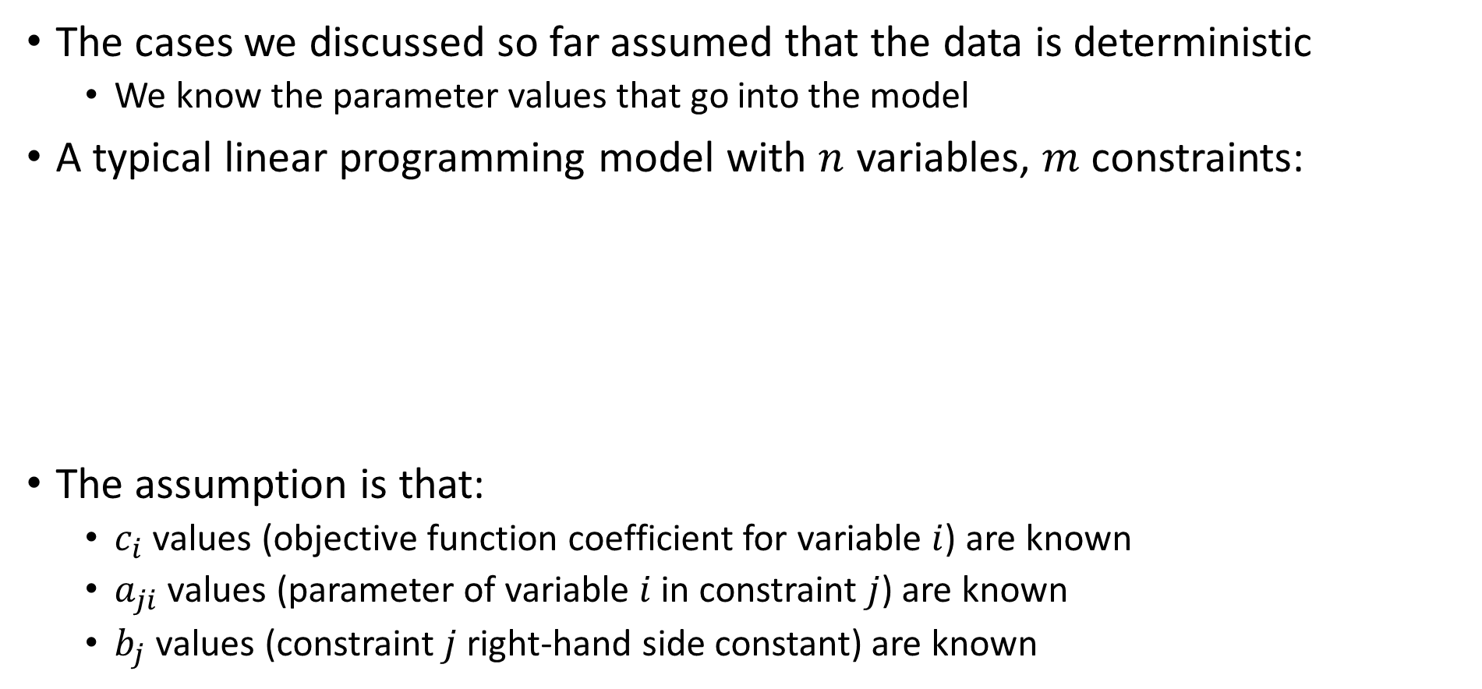
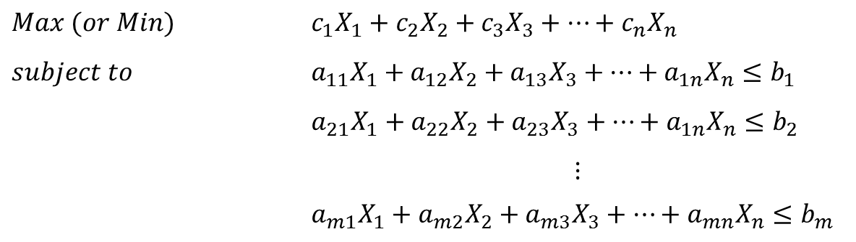
Sensitivity Analyses and Excel Reports
The cases we discussed so far assumed that the data is deterministic
  We know the parameter values that go into the model
A typical linear programming model with $n$ variables, $m$ constraints:
The assumption is that:
  $c_{i}$ values (objective function coefficient for variable $i$) are known
  $a_{ji}$ values (parameter of variable $i$ in constraint $j$) are known
  $b_{j}$ values (constraint $j$ right-hand side constant) are known
$$Max (or Min)$$ | $$c_{1}X_{1}+c_{2}X_{2}+c_{3}X_{3}+…+c_{n}X_{n}$$
$$subject to$$ | $$a_{11}X_{1}+a_{12}X_{2}+a_{13}X_{3}+…+a_{1n}X_{n}≤b_{1}$$
 | $$a_{21}X_{1}+a_{22}X_{2}+a_{23}X_{3}+…+a_{1n}X_{n}≤b_{2}$$
 | $$⋮$$
 | $$a_{m1}X_{1}+a_{m2}X_{2}+a_{m3}X_{3}+…+a_{mn}X_{n}≤b_{m}$$
Problem data (Parameters)

Slide 5
Sensitivity Analyses and Excel Reports
Sensitivity analyses prove to be useful!
  The parameter values might be rough estimates and a decision maker would like to see if what they are doing will be still optimal when those estimated values change
  There might be opportunities to change the values of some parameters, thus, a decision maker would like to see if it makes sense to invest in such opportunities
  The main questions we will answer:
    What happens if there are changes in the objective function coefficients
    What happens if there are changes in the constraint right-hand side constants
  Additionally, we will briefly discuss effects of changes in the model
    What happens if a constraint is added or removed
    What happens if a decision variable is introduced or omitted
Excel Solver’s Sensitivity Report provides valuable information for sensitivity analyses

Slide 6
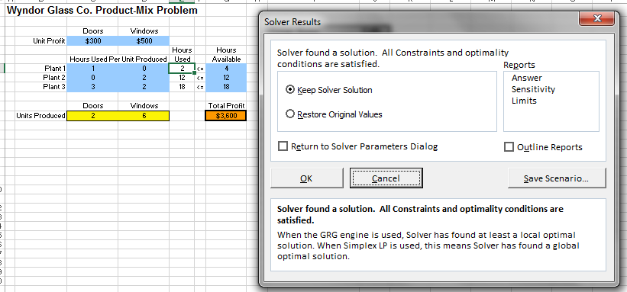

Excel Reports
Excel Solver Reports: Answer, Sensitivity, Limits
  You can generate a report by selecting it on the ‘Reports’ menu from the ‘Solver Results’ window
  Each report will be
  generated in a new sheet
  We will use Sensitivity
  Report heavily

Slide 7
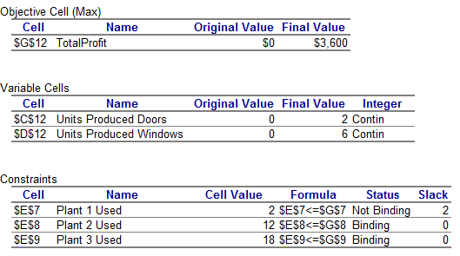
Excel Reports
Answer Report:
Objective Cell part:
Shows the cell and name (if any given), original value (before the model is solved, based on the initial values of the decision variables), and the final value of the objective function after the model is solved
Variable Cells part:
Shows the cells and the names (if any), original values (before the model is solved, the initial values in the model), and the final values after the model is solved for decision variable cells. Also, ‘whether the decision variables are forced to be integers or not’ is noted.
Constraints part:
Shows the cells and names (if any), formula, and cell value, status, and slack after the model is solved.
Cell value is the final value of the constraint left side after the model is solved. For instance, 2 hours is used from Plant 1 and 12 hours is used from Plant 2
Status will be either binding or not binding
Slack is the unutilized portion of the resource
Binding: When the resource is fully utilized (with the optimal values of the decision variables, left-hand-side and right-hand-side values are equal)
Not-binding: When the resource is not fully utilized.

Slide 8
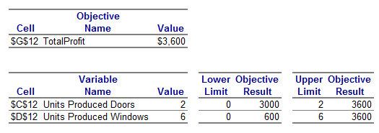
Excel Reports
Limits Report: tells what can be the limits of the decision variables
If we produce 6 windows, we should produce at least 0 doors (lower limit for doors), and when we produce 0 doors (while producing 6 windows), the profit will be 3000
If we produce 6 windows, we can produce at most 2 doors (upper limit for doors), and when we produce 2 doors (while producing 6 windows), the profit will be 3600
If we produce 2 doors, we can produce at most 6 windows (upper limit for windows), and when we produce 6 windows (while producing 2 doors), the profit will be 3600
If we produce 2 doors, we should produce at least 0 windows (lower limit for windows), and when we produce 0 windows (while producing 2 doors), the profit will be 600

Slide 9
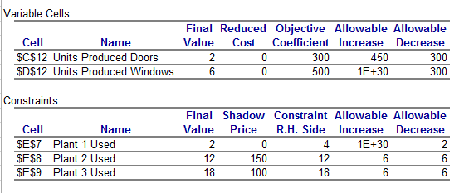
Excel Reports
Sensitivity Report:
This part is used to analyze the effects of changes in the objective function
Final Value is the optimal value of the decision variables
Reduced Cost is how much the objective function value would change by increasing (if possible) the variables by one unit from the current values
Objective Coefficient is the objective function coefficient for the variable
Allowable Increase and Allowable Decrease will tell us how much we change the objective coefficient without changing the optimal solution
  MORE ON THIS LATER
This part is used to analyze the effects of changes in the constraints
Final Value is the final value left-side of the constraint
Shadow Price is how much the objective function value would change by increasing (if possible) the constraint right-side by one unit from the current values
Constraint R.H. Side is the right-hand side constants for the constraints
Allowable Increase and Allowable Decrease will tell us how much we change the objective coefficient without changing the shadow price
  MORE ON THIS LATER

Slide 10
Outline
Sensitivity Analysis and Excel Reports (Chapter 5)
Single Change in the Objective Function (Chapter 5.3)
Single Change in a Constraint (Chapter 5.5)
Effect of Simultaneous Changes
  Changes in the Objective Function (Chapter 5.4)
  Changes in Constraints (Chapter 5.6)
Changes in the Model (not in the textbook)
Linear Programming Duality (not in the textbook)
  Formulating the dual problem
  Primal-dual relations
  Economic Interpretation

Slide 11
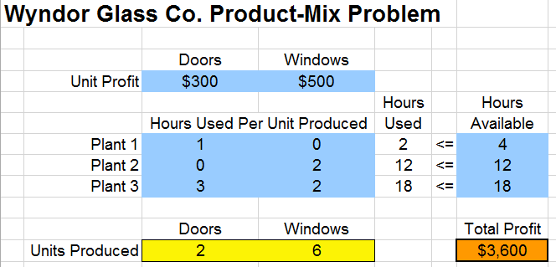
Single Change in the Objective Function
It is a possibility that one of the coefficients in the objective function of a model will change
  It is important to analyze what the effect of this change will be
  This can be done using the Sensitivity Report
Consider the Wyndor Glass Co. Product Mix Problem
Answers Report:

Slide 12
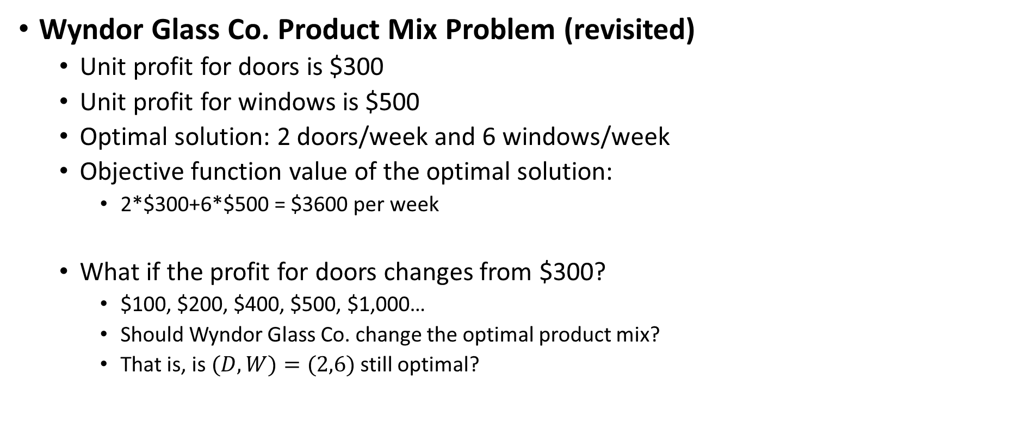
Single Change in the Objective Function
Wyndor Glass Co. Product Mix Problem (revisited)
  Unit profit for doors is $300
  Unit profit for windows is $500
  Optimal solution: 2 doors/week and 6 windows/week
  Objective function value of the optimal solution:
    2*$300+6*$500 = $3600 per week
  What if the profit for doors changes from $300?
    $100, $200, $400, $500, $1,000…
    Should Wyndor Glass Co. change the optimal product mix?
    That is, is $(D,W)=(2,6)$still optimal?

Slide 13
Single Change in the Objective Function
Wyndor Glass Co. Product Mix Problem (revisited)
  When there is a single change in the objective function, we can re-solve the problem
$200 per door, no change in the optimal solution
$500 per door, no change in the optimal solution
$1,000 per door, change in the optimal solution

Slide 14
Single Change in the Objective Function
Wyndor Glass Co. Product Mix Problem (revisited)
  One option, therefore, is to re-solve the problem with the new values
  We can use the Sensitivity Report
But, this is not so practical
For small changes, we might need to solve too many problems
And it takes time to solve large problems!
And we would not know when to stop!
The upper section is about the changes in the objective function

Slide 15
Single Change in the Objective Function
Wyndor Glass Co. Product Mix Problem (revisited): Sensitivity Report
How much you can increase the coefficient
How much you can decrease the coefficient
Recall:
Final Value: Optimal values of the decision variables
Reduced cost: For variables whose final values are not zero, they should be 0!
  It means that we get the best out of those variables, so we cannot do more!
So that the optimal solution will not change
(when there is a single change)

Slide 16
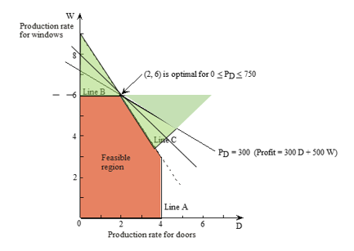
Single Change in the Objective Function
Wyndor Glass Co. Product Mix Problem (revisited): Sensitivity Report

Slide 17
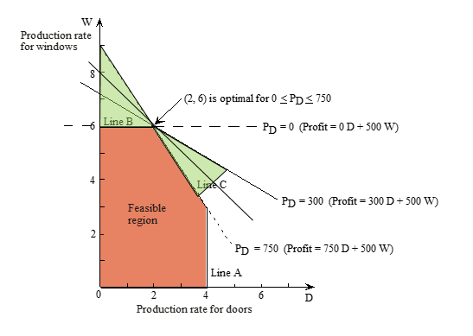
Single Change in the Objective Function
Wyndor Glass Co. Product Mix Problem (revisited): Sensitivity Report
Note that even if the optimal solution does not change, the objective function value will change because an objective function coefficient changes!

Slide 18
Single Change in the Objective Function
Wyndor Glass Co. Product Mix Problem (revisited): Sensitivity Report
    Suppose that unit profit for doors increases from 300 to 500, everything else is the same
      Increase is: $500-$300=200 and 200 < Allowable Increase for doors (which is 450 from report)
        So, the optimal solution will not change, i.e., (D,W)=(2,6) will still be the optimum
    Suppose that unit profit for doors increases from 300 to 1000, everything else is the same
      Increase is: $1000-$300=700 and 700 >= Allowable Increase for doors (which is 450 from report)
        So, the optimal solution will change, i.e., now (D,W)=(4,3) becomes the optimum
    Suppose that unit profit for windows decreases from 500 to 400, everything else is the same
      Decrease is: $500-$400=100 and 100 < Allowable Decrease for windows (which is 300 from report)
        So, the optimal solution will not change, i.e., (D,W)=(2,6) will still be the optimum
    Suppose that unit profit for doors decreases from 500 to 100, everything else is the same
      Decrease is: $500-$100=400 and 400 >= Allowable Decrease for windows (which is 300 from report)
        So, the optimal solution will change, i.e., now (D,W)=(4,3) becomes the optimum

Slide 19
Outline
Sensitivity Analysis and Excel Reports (Chapter 5)
Single Change in the Objective Function (Chapter 5.3)
Single Change in a Constraint (Chapter 5.5)
Effect of Simultaneous Changes
  Changes in the Objective Function (Chapter 5.4)
  Changes in Constraints (Chapter 5.6)
Changes in the Model (not in the textbook)
Linear Programming Duality (not in the textbook)
  Formulating the dual problem
  Primal-dual relations
  Economic Interpretation

Slide 20
Single Change in a Constraint
It is a possibility that the resources available change!
  Here, we assume that constraint right hand side values are constants
    So, all variables are on the left side, and right side has just constants
  It is important to analyze what the effect of this change will be
  This can be done using the Sensitivity Report
Consider the Wyndor Glass Co. Product Mix Problem
Answers Report:

Slide 21
Single Change in a Constraint
Wyndor Glass Co. Product Mix Problem (revisited)
  Available time in Plant 1: 4 hours per week
  Available time in Plant 2: 12 hours per week
  Available time in Plant 3: 18 hours per week
  Optimal solution: 2 doors/week and 6 windows/week
    Time used from Plant 1 is 2 hours per week (1*D+0*W=2)
    Time used from Plant 2 is 12 hours per week (0*D+2*W=12)
    Time used from Plant 3 is 18 hours per week (3*D+2*W=18)
  What if Plant 2 has more hours available?
    More importantly,
      How much you would increase your profit by increasing the hours in Plant 2?
      How much would you pay to have one additional hour in Plant 2?

Slide 22
Single Change in a Constraint
Wyndor Glass Co. Product Mix Problem (revisited)
  When there is a single change in one constraint, we can re-solve the problem
Plant 2 time: From 12→13
1 additional hour at Plant 2, $150 increase in weekly profit
Profit changes from $3600 to $3750
Plant 2 time: From 13→18
5 more hours at Plant 2, $750 increase in weekly profit, $150 for each added hour
Profit changes from $3750 to $4500
Plant 2 time: From 18→20
2 more hours at Plant 2, no change in the weekly profit
Profit stays at $4500

Slide 23
Single Change in a Constraint
Wyndor Glass Co. Product Mix Problem (revisited)
  One option, therefore, is to re-solve the problem with the new values
  We can use the Sensitivity Report
But, this is not so practical
For small changes, we might need to solve too many problems
And it takes time to solve large problems!
And we would not know when to stop!
The lower section is about the changes in the constraints

Slide 24
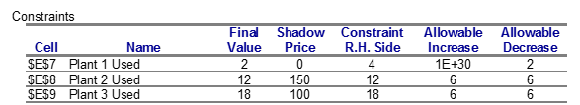
Single Change in a Constraint
Wyndor Glass Co. Product Mix Problem (revisited): Sensitivity Report
Recall:
Final Value is the final value left-side of the constraint
Constraint R.H. Side is the right-hand side constants for the constraints
Shadow Price is how much the objective function value would change by increasing (if possible) the constraint right-side by one unit from the current values
How much you can increase the right-hand side value
How much you can decrease the right-hand side value
So that the shadow price will not change
(when there is a single change)

Slide 25
Single Change in a Constraint
Shadow Price:
  Shadow price: Given an optimal solution and the corresponding value of the objective function for a linear programming model, the shadow price for a functional constraint is the rate at which the value of the objective function changes by 1 unit change on the right-hand-side
    In short, it is the current marginal value of the constraint right-hand-side
  For instance, current shadow price for Plant 1 time availability is 0
    We currently have 4 hours available in Plant 1 and we are using only 2 hours from Plant 1 at the current optimal solution
    Adding one more hour to Plant 1 has no benefit (or removing 1 hour from Plant 1 has no harm)
      We are already not using what we have, so one additional hour would not improve the profit

Slide 26
Single Change in a Constraint
Wyndor Glass Co. Product Mix Problem (revisited): Sensitivity Report
  Allowable Increase and Allowable Decrease define the range of the constraint right-hand side so that the shadow price will not change (when there is a single change)
    They do not tell anything for the optimal solution
    Shadow Price for Plant 1 time availability: 0
    If we increase Plant 1 time
      from 4 to 5, weekly profit will not change because shadow price is 0
      Its shadow price will still be 0 since there is 5-4=1 unit increase, which is within allowable increase
      Therefore, if we further increase Plant 1 time from 5 to 6, weekly profit will increase by $0 and shadow price will be the same

Slide 27
Single Change in a Constraint
Wyndor Glass Co. Product Mix Problem (revisited): Sensitivity Report
  Allowable Increase and Allowable Decrease define the range of the constraint right-hand side so that the shadow price will not change (when there is a single change)
    Shadow Price for Plant 1 time availability: 0
    If we decrease Plant 1 time
        From 4 to 3, weekly profit will not change because current shadow price is 0
        The shadow price will not change as well because 4-3=1 unit decrease is allowable
        Therefore, if we further decrease Plant 1 time from 3 to 2, weekly profit will increase by $0 and shadow price will be the same
        But, if we further decrease Plant 1 time from 2 to 1, we cannot say that weekly profit will not change, because shadow price might change since 4-1=3 units of decrease, which is not within the allowable decrease range

Slide 28
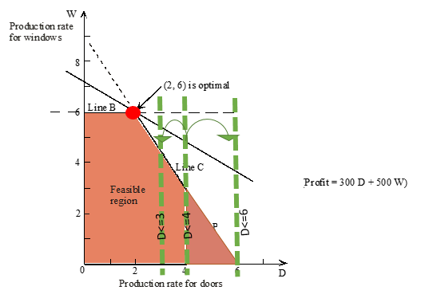
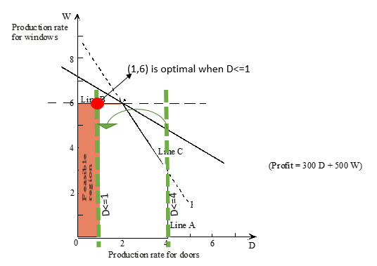
Single Change in the Objective Function
Wyndor Glass Co. Product Mix Problem (revisited): Sensitivity Report

Slide 29
Single Change in a Constraint
Wyndor Glass Co. Product Mix Problem (revisited): Sensitivity Report
    Increasing capacity of Plant 2 by 1 hour increases the profit by $150
      Would you pay $100 to have 1 more hour in Plant 2? Yes, shadow price is $150>$100
      Would you pay $200 to have 1 more hour in Plant 2? No, shadow price is $150<$200
    Allowable Increase for Plant 2 is 6
      This means that, each additional hour, up to 6 additional hours, will increase the profit by $150 because the shadow price is not changing
      So, when Plant 2 time becomes 18, the profit will increase by 6*$150=$900
      When Plant 2 times becomes 19, we do not know the increase in profit when Plant 2 time increases from 18 to 19 (shadow price could change)!
    Allowable Decrease for Plant 2 is 6
      Each hour decreased from Plant 2 time will decrease profit by $150 up to 6 hours decrease

Slide 30
Single Change in a Constraint
Wyndor Glass Co. Product Mix Problem (revisited): Sensitivity Report

Slide 31
Single Change in a Constraint
Note on shadow prices:
  Shadow price is the change in the objective function by one unit increase in a constraint right hand side!
    Say, a constraint right-hand-side is 10 and the current shadow price is 5
      If we increase the constraint right-hand-side from 10 to 11, the objective function will increase by 5
      If we decrease the constraint right-hand-side from 10 to 9, the objective function will decrease by 5
  Shadow prices can be negative!
    Say, a constraint right-hand-side is 10 and the current shadow price is -5
      If we increase the constraint right-hand-side from 10 to 11, the objective function will increase by -5 (i.e., it will decrease by 5)
      If we decrease the constraint right-hand-side from 10 to 9, the objective function will decrease by -5 (i.e., it will increase by 5)

Slide 32
Outline
Sensitivity Analysis and Excel Reports (Chapter 5)
Single Change in the Objective Function (Chapter 5.3)
Single Change in a Constraint (Chapter 5.5)
Effect of Simultaneous Changes
  Changes in the Objective Function (Chapter 5.4)
  Changes in Constraints (Chapter 5.6)
Changes in the Model (not in the textbook)
Linear Programming Duality (not in the textbook)
  Formulating the dual problem
  Primal-dual relations
  Economic Interpretation

Slide 33
Effect of Simultaneous Changes
When there is a single change in the objective function, we can use the Allowable Increase and Allowable Decrease to see if the optimal solution will not change
When there is a single change in a constraint right-hand side, we can use the Allowable Increase and Allowable Decrease to see if the shadow price will not change
However, when there are multiple changes in the objective function or in the constraints, we cannot directly use Allowable Increase or Allowable Decrease
  For instance, each change being within allowable increase or allowable decrease does not guarantee that there will not be a change

Slide 34
Effect of Simultaneous Changes
Simultaneous Changes in the Objective Function (Chapter 5.4):
Consider the Wyndor Glass Co. Product Mix Problem: Suppose that the unit profit for doors changes from $300 to $600 and unit profit for windows changes from $500 to $300
  Each change is within allowable range
    Change in unit profit for doors:
      600-300=300 increase and 300<450
      where 450 is allowable increase for unit profit of doors
    Change in unit profit for windows:
      500-300=200 decrease and 200<300,
      where 300 is the allowable decrease for unit profit of windows
  But the optimal solution will change:
    With these changes, (4,3) is optimal

Slide 35
Effect of Simultaneous Changes
Simultaneous Changes in the Objective Function (Chapter 5.4):
When there are multiple changes in objective function coefficients, instead of looking whether each change is within the allowable range, we will look at the total percentage change to see if the optimal solution will remain the same
  100% Rule Simultaneous Changes in Objective Function Coefficients: If simultaneous changes are made in the coefficients of the objective function, calculate for each change the percentage of the allowable change (increase or decrease) for that coefficient to remain within its allowable range. If the sum of the percentage changes does not exceed 100 percent, the original optimal solution definitely will still be optimal.
    If the sum is 100% or exceeds 100%, then we cannot be sure. That is, the optimal solution may or may not change!

Slide 36
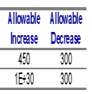
Effect of Simultaneous Changes
Simultaneous Changes in the Objective Function (Chapter 5.4):
Consider the Wyndor Glass Co. Product Mix Problem:
  Unit profit for doors changes: $300 → $450
  Unit profit for windows changes: $500 → $400
  Apply 100% Rule:
    Unit profit for doors increases: % change = increase / allowable increase = (450-300)/450 = 33.3 %
    Unit profit for windows decreases: % change = decrease / allowable decrease = (500-400)/300 = 33.3%
    Total change: 33.3%+33.3% = 66.6%
      66.6% < 100%, so we can say that the optimal solution will not change, i.e., (2,6) will be still optimal

Slide 37
Effect of Simultaneous Changes
Simultaneous Changes in the Objective Function (Chapter 5.4):
Consider the Wyndor Glass Co. Product Mix Problem:
  Unit profit for doors changes: $300 → $600
  Unit profit for windows changes: $500 → $300
  Apply 100% Rule:
    Unit profit for doors increases: % change = increase / allowable increase = (600-300)/450 = 66.6 %
    Unit profit for windows decreases: % change = decrease / allowable decrease = (500-300)/300 = 66.6%
    Total change: 66.6%+66.6% = 133.3%
      133.3% >= 100%, so we cannot say that the optimal solution will not change
      Indeed, (4,3) becomes the optimal

Slide 38
Effect of Simultaneous Changes
Simultaneous Changes in the Objective Function (Chapter 5.4):
Consider the Wyndor Glass Co. Product Mix Problem:
  Unit profit for doors changes: $300 → $150
  Unit profit for windows changes: $500 → $250
  Apply 100% Rule:
    Unit profit for doors decreases: % change = decrease / allowable decrease = (300-150)/300 = 50.0 %
    Unit profit for windows decreases: % change = decrease / allowable decrease = (500-250)/300 = 83%
    Total change: 50%+83% = 133%
      133% >= 100%, so we cannot say that the optimal solution will not change
      Indeed, (2,6) is still optimal

Slide 39

Effect of Simultaneous Changes
Simultaneous Changes in Constraint Right-Hand Sides (Chapter 5.6):
Consider the Wyndor Glass Co. Product Mix Problem:
  Plant 2 time changes: 12→ 13
    So, profit should increase by $150?
  Plant 3 time changes: 18→ 17
    So, profit should decrease by $100?
  So, one expects $150-$100=$50 change in the profit
  However, if these changes are made simultaneously, we do not know if the shadow prices remain valid
  A quick way to check the effect of these two changes is to re-solve the problem:
Indeed, there is $50 increase in the profit
So, shadow prices are valid for these particular simultaneous changes…
But how long will they remain valid if we continue shifting production hours?

Slide 40
Effect of Simultaneous Changes
Simultaneous Changes in Constraint Right-Hand Sides (Chapter 5.6):
When there are multiple changes in constraint right-hand sides, instead of looking whether each change is within the allowable range, we will look at the total percentage change to see if the shadow prices will remain valid
  100% Rule Simultaneous Changes in Constraint Right-Hand Sides: The shadow prices remain valid for predicting the effect of simultaneously changing the right-hand sides of some of the functional constraints as long as the changes are not too large. To check whether the changes are small enough, calculate for each change the percentage of the allowable change (decrease or increase) for that right-hand side to remain within its allowable range. If the sum of the percentage changes does not exceed 100 percent, the shadow prices definitely will still be valid.
    If the sum is 100% or exceeds 100%, then we cannot be sure. That is, the shadow prices may or may not change!

Slide 41
Effect of Simultaneous Changes
Simultaneous Changes in Constraint Right-Hand Sides (Chapter 5.6):
Consider the Wyndor Glass Co. Product Mix Problem:
  Plant 2 time changes: 12→ 13
    So, profit should increase by $150?
  Plant 3 time changes: 18→ 17
    So, profit should decrease by $100?
  Apply 100% Rule:
    Plant 2 time increases: % change = increase / allowable increase = (13-12)/6 = 16.6 %
    Plant 3 time decreases: % change = decrease / allowable decrease = (18-17)/6 = 16.6 %
    Total change: 16.6%+16.6% = 33.3%
      33.3% < 100%, so shadow prices will remain valid
      Therefore, we can say that profit will change by $150-$100 = $50

Slide 42
Effect of Simultaneous Changes
Simultaneous Changes in Constraint Right-Hand Sides (Chapter 5.6):
Consider the Wyndor Glass Co. Product Mix Problem:
  Plant 2 time changes: 12→ 16
    So, profit should increase by 4x$150?
  Plant 3 time changes: 18→ 13
    So, profit should decrease by 5x$100 (change by -5x$100)?
  Apply 100% Rule:
    Plant 2 time increases: % change = increase / allowable increase = (16-12)/6 = 66.6 %
    Plant 3 time decreases: % change = decrease / allowable decrease = (18-13)/6 = 83.33 %
    Total change: 66.6%+83.3%= 150%
      150% > 100%, so shadow prices can change
      Indeed, they will
      If they would not change, we expect 4*150-5*100=$100
      change in the profit
      But the change is 3600-3250=$350

Slide 43
Outline
Sensitivity Analysis and Excel Reports (Chapter 5)
Single Change in the Objective Function (Chapter 5.3)
Single Change in a Constraint (Chapter 5.5)
Effect of Simultaneous Changes
  Changes in the Objective Function (Chapter 5.4)
  Changes in Constraints (Chapter 5.6)
Changes in the Model (not in the textbook)
Linear Programming Duality (not in the textbook)
  Formulating the dual problem
  Primal-dual relations
  Economic Interpretation

Slide 44
Changes in Model
We might need to add a new constraint or remove an existing constraint
We might add a new variable or remove an existing variable from the model
How will such a change affect the model outcome?
  Will we be in a better situation? Worse situation? Or maintain the current situation?
    →if the objective is maximization
    “Better” means higher objective function value at the optimal solution
    →if the objective is minimization
    “Better” means lower objective function value at the optimal solution
Let’s consider the extended Island Example from Week 1 lecture notes
  We have 5 items
  50 lbs limit and $150 budget
  Want to maximize # of days we can survive
    →Bread: 2 days/lb
    →Steak: 5 days/lb
    →Chicken: 3days/lb
    →Chocolate: 6days/lb
    →Cheese: 4days/ln
    1 lb of bread costs you $3
    1 lb of steak costs you $6
    1 lb of chicken costs you $7
    1 lb of chocolate costs you $15
    1 lb of cheese costs you $8

Slide 45
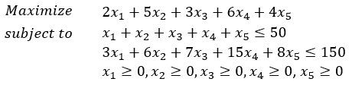


Changes in Model
Island Example: 25lbs of chocolate, 0 lbs of others, survive 125 days
Adding a constraint: Suppose the following constraint is added
  Cannot get more meat (steak+chicken) than bread, thus, add
$$x_{2}+x_{3}≤x_{1}$$
With the addition of this new constraint, you can only survive for 116.67 days
In this case, adding the constraint resulted in a worse situation
In some cases, adding a constraint will not change the solution (suppose you added $x_{1}$<=100)
But, there is no case where adding a constraint can result in a better situation

Slide 46
Changes in Model
Island Example: 25lbs of chocolate, 0 lbs of others, survive 125 days
Removing a constraint: Suppose the following budget constraint is removed
  That is, we remove from the model
With the removal of the budget constraint, you can survive for 300 days
In this case, removing the constraint resulted in a better situation
In some cases, removing a constraint will not change the solution (for instance, remove the bag limit instead of budget limit)
But, there is no case where removing a constraint can result in a worse situation

Slide 47
Changes in Model
Island Example: 25lbs of chocolate, 0 lbs of others, survive 125 days
Adding a variable: Suppose that you can take tomatoes (3days/lb, $1/lb)
With the addition of this new variable, you can survive for 190 days
In this case, adding the variable resulted in a better situation
In some cases, adding a variable will not change the situation (suppose new variable is 0 in the new optimal solution)
But, there is no case where adding a variable can result in a worse situation (unless the new variable comes with additional constraints)

Slide 48
Changes in Model
Island Example: 25lbs of chocolate, 0 lbs of others, survive 125 days
Removing a variable: Suppose that you cannot take steak
With the removal of this variable, you can only survive for 100 days
In this case, removing the variable resulted in a worse situation
In some cases, removing a variable will not change the situation (suppose you removed cheese instead of steak)
But, there is no case where removing a variable can result in a better situation

Slide 49
Changes in Model
Changes in the model settings (variables and constraints) will change the feasible region, i.e., the set of alternatives
Basically, having more alternatives implies that you can select a better alternative if there is one among the new alternatives
  If not, keep your current best alternative
  In summary:
    If a constraint is added, feasible region cannot get bigger, so you cannot do better
    If a constraint is removed, feasible region cannot decrease, so you cannot do worse
    If a variable is added, number of feasible solutions cannot decrease, so you cannot do worse
    If a variable is removed, number of feasible solutions cannot increase, so you cannot do better

Slide 50
Outline
Sensitivity Analysis and Excel Reports (Chapter 5)
Single Change in the Objective Function (Chapter 5.3)
Single Change in a Constraint (Chapter 5.5)
Effect of Simultaneous Changes
  Changes in the Objective Function (Chapter 5.4)
  Changes in Constraints (Chapter 5.6)
Changes in the Model (not in the textbook)
Linear Programming Duality (not in the textbook)
  Formulating the dual problem
  Primal-dual relations
  Economic Interpretation

Slide 51
Linear Programming Duality
Every linear programming problem has an associated problem called the dual
  Original problem is known as the primal
  The relationships between the primal and dual prove useful in a variety of ways
Consider a maximization (minimization) primal problem
  Dual is a minimization (maximization) problem
  Dual uses same parameters in different locations

Slide 52
Formulating the Dual Problem
The objective of the dual is opposite of the objective of the primal
  The number of constraints (excluding non-negativity constraints) in the primal is equal to the number of decision variables in the dual
  Number of decision variables in the primal is equal to the number of constraints in the dual
Coefficients in the objective function of the primal problem:
  Are right-hand sides of the functional constraints in the dual problem
Right-hand sides of the functional constraints in the primal problem:
  Are the coefficients in the objective function of the dual problem

Slide 53
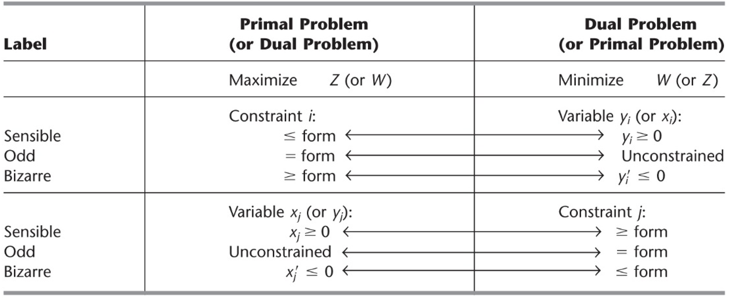
Formulating the Dual Problem
Taking the dual of a given linear programming model (primal)

Slide 54
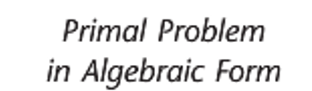
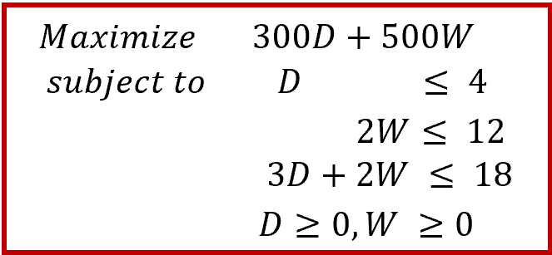
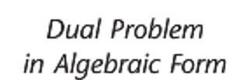
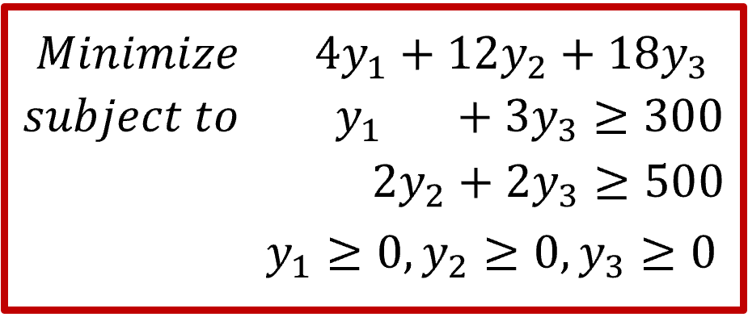
Formulating the Dual
Consider our Wyndor Example:
                Define a decision variable for each constraint
                Say y₁ for constraint 1, y₂ for constraint 2, and y₃ for constraint 3
                Objective will be minimization
                Objective function will be sum of the right-side of the primal constraints multiplied with the corresponding dual variables
                Constraints of the dual will be defined by the columns of the primal

Slide 55
Formulating the Dual
Another example:
Primal
Dual

Slide 56
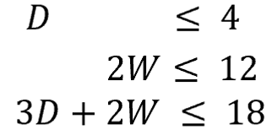

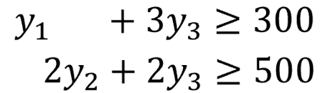

Primal-Dual Relations
Weak duality property
  For a primal maximization (minimization) problem: If x is a feasible solution for the primal problem and y is a feasible solution for the dual problem, then cx <= yb (cx >= yb )
  Illustration with Wyndor example:
    Suppose we have a primal solution (D, W)
    Suppose we have a dual solution (y₁,y₂,y₃)
    So
y₁D+2y₂W+y₃(3D+2W) <=
D(y₁+3y₃)+W(2y₂+2y₃) >=
<=
<=

Slide 57
Primal-Dual Relations
Strong duality property
  If x* is an optimal solution for the primal problem and y* is an optimal solution for the dual problem, then cx* = y*b.
Symmetry property
  Dual of the dual is primal!!

Slide 58
Primal-Dual Relations
Fundamental theory of duality
  Defines the relations between the primal and dual
    If Primal is unbounded, Dual is infeasible
    If Dual is unbounded, Primal is infeasible
    If Primal is infeasible
      Dual can be unbounded? Possible!
      Dual can have optimum solution? No!!
      Dual can be infeasible? Possible!
 | I | O | U
I | Yes |  | Yes
O |  | Yes
U | Yes

Slide 59
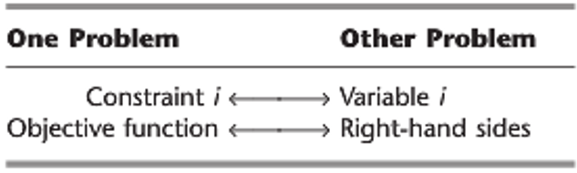
Primal-Dual Relations
Complementary slackness:
  If x is not optimal for the primal problem, then y is not feasible for the dual problem.
  Given optimum solution to one, we can get the optimum solution of the other
  Recall that
Complementary slackness states:
  The objective function values should be the same
  If a constraint is not ‘tight’ → then the associated variable is zero
  If a variable is not zero → then the associated constraint is tight

Slide 60
Primal-Dual Relations
Complementary slackness:
  Recall that optimum solution to Wyndor is D*=2 and W*=6.
  Let’s get the optimum dual solution → (y₁*,y₂*,y₃* )=?
    The objective function values should be the same
    300D*+500W*=4y₁*+12y₂*+18y₃* → 3600=4y₁*+12y₂*+18y₃*
    If a constraint is not ‘tight’ then the associated variable is 0
      D*<=4 → 2<4 → not tight → so y₁*=0
      2W*<=12 → 12=12 → tight → so nothing about y₂* so far
      3D*+2W*<=18 → 18=18 → tight → so nothing about y₃* so far
    If a variable is not zero then the associated constraint is tight
      D*=2>0 → so first constraint → y₁*+3y₃*=300
      W*=6>0 → so second constraint → 2y₂*+2y₃* =500

Slide 61
Primal-Dual Relations
Complementary slackness for Wyndor:
  So we have three unknowns three equations
    → 4y₁*+12y₂*+18y₃*=3600
    → y₁*+3y₃*=300
    → 2y₂*+2y₃* =500
  Furthermore, we already know that
    → y₁*=0
  So, we can solve for y₁*, y₂*, y₃*
    → (y₁*,y₂*,y₃* )=(0, 150, 100)

Slide 62
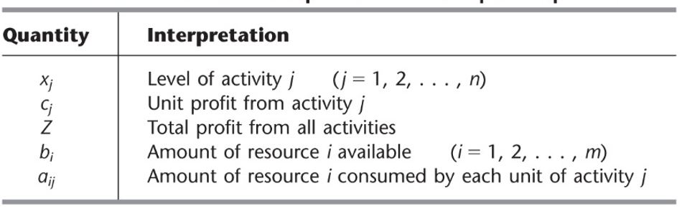

Economic Interpretation
The primal problem is:
Objective function of the dual:
  b_{i}y_{i} can thereby be interpreted as the current contribution to profit by having b_{i} units of resource i available for the primal problem.

Slide 63
Economic Interpretation
Shadow price: Given an optimal solution and the corresponding value of the objective function for a linear programming model, the shadow price for a functional constraint is the rate at which the value of the objective function changes by 1 unit change on the right-hand-side
  The dual variable y_{i} is interpreted as the contribution to profit per unit of resource i, when the current set of basic variables is used to obtain the primal solution.
  So y_{i} are shadow prices

Slide 64
Economic Interpretation
Consider the Wyndor problem…
  If we produce 1 unit of doors, we will consume 1 hour from Plant 1 and 3 hours from Plant 3
  So we could have gained y₁+3y₃ to the profit if we have not produced 1 unit of doors
  Also recall that 1 unit of doors has a profit of c1=300
  So if the contribution of the resources used by 1 door is greater than the profit we will get from 1 door, we would not produce,
  Therefore, we have:
    If y₁+3y₃ >300 → D=0
    Recall from complementary slackness, if the constraint is not tight, then the associated variable should be 0

Slide 65
Economic Interpretation
Now let’s look at the shadow prices
  Let’s consider resource 2 (i.e., plant 2 time)
  If y₂>0, this means that having additional one unit of resource 2 (i.e., 1 more hour in Plant 2) will increase our profit
    If we are at the optimum solution, then we should have used all of the hours in Plant 2, otherwise, we would not be in the optimum solution because, by using some more of the available time in Plant 2, we could increase our profit..
    Therefore, if y₂>0, we should currently be using all the time available in plant 2, that is, we should have 2W=16
    Recall from complementary slackness, if a variable is not zero, then the associated constraint should be tight

